Slide 1
JavaScript, JQuery & AJAX
Author: Duy Nguyen
Trainer: Ngoc Nguyen
Notes:
10’

Slide 2
Introduction
Your role
Your background and experience in the subject
HTML, CSS, JavaScript
What do you want from this course

Slide 3
Objectives
JavaScript programming
Basic knowledge
Advance knowledge
Ajax
jQuery and its features
Basic knowledge
$.ajax, Defer and Promise

Slide 4

Prerequisite
Have knowledge
Html(5), Css(3)
Editor:
VS Code, Eclipse, Notepad++, Brackets, Sublime Text …
Developer tool:
Chrome developer tool…

Slide 5
Assessment Disciplines & Timetable
Assessment Disciplines
Class Participation : Required
Assignment Completion : 100%
Pass Criteria: >=70%
Course Timetable
Lecture Duration: 4 hours
Demo & Practice: 2 hours
Assignment Duration : Optional

Slide 6
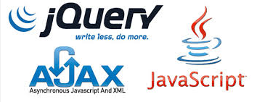
Agenda
JavaScript (JS)
Basic JS (operation, conditional, object, functions, etc)
Advance JS (Prototype, Inheritance, Scope)
Ajax
jQuery
Selector
Events, Effects
DOM Manipulation
$.ajax()
Defer and Promise

Slide 7
JavaScript Overview
Notes:
15’

Slide 8
What is JavaScript?
An interpreted programming language with object-oriented capability (optional JIT Compilation support).
Lightweight and runs on the client side and interpreted by browser
Loosely typed and can be embedded directly into HTML pages
Everyone can write/run without license
NOT JAVA

Slide 9
What can client-side JavaScript do?
Contains an extended set of functionality to interface with the web browser DOM (Document Object Model)
Event detection and handling
Support pre-defined Objects (window, document, location etc).
Manipulate HTML elements
Make ajax request to server
Others capabilities, like form validation, cookies storage, etc.

Slide 10
Pros and Cons of JavaScript
Pros
Speed: Fast executed on client-side
Simplicity: Simple to learn and implement
Versatility: Play nicely with other languages
ServerLoad: Reduce the demand on web server.
Cons
Security: can be exploited for malicious purpose.
Render Varies: may rendered differently in old browser engines.

Slide 11
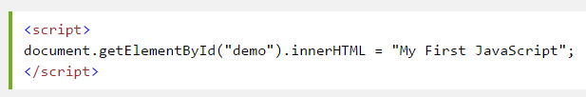
Location of JS in html
JavaScript is put inside HTML between <script>
<script> tag could be put in any places inside a html page (at <head>, <body>…)
Can be kept in an external JavaScript file and referenced in HTML code

Slide 12
Location of JS (example):
/js/script.js
alert("This is external JavaScript");
<!DOCTYPE HTML PUBLIC "-//W3C//DTD HTML 4.01 Transitional//EN"
"http://www.w3.org/TR/html4/loose.dtd">
<html>
<head>
<title>JavaScript Location Example</title>
<script type="text/javascript“ src=“js/script.js”></script>
<script type="text/javascript">
alert(“This is inline JavaScript in <head> tag.");
</script>
</head>
<body>
<script type="text/javascript">
alert(“This is inline JavaScript in <body> tag.");
</script>
<h1>This is a JavaScript Location Example</h1>
</body>
</html>

Slide 13
Programming with Javascript

Slide 14
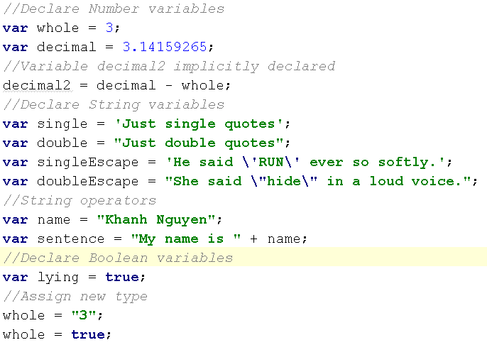
Variables
Begin with a letter or $, _
Case sensitive
There are global scope and functional (lexical) scope
Declare with var for global and local variables. No var for function parameters
No type declaration

Slide 15
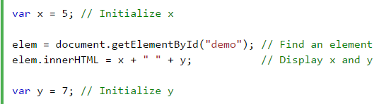
Variables Hoisting
A variable can be used before it has been declared
Hoisting (JS behavior) moves all declarations to the top of current scope.
Best practice:
Declare variables on top

Slide 16
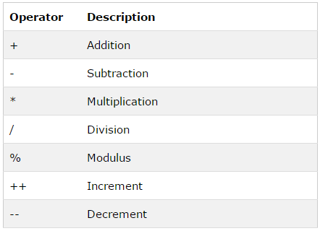
Operators
Arithmetic Operators

Slide 17
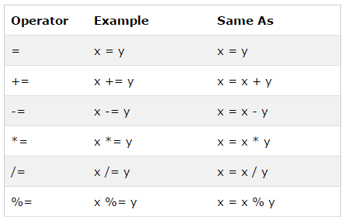
Operators (cont)
Assignment Operators

Slide 18
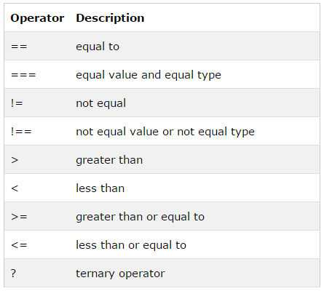
Operators (cont)
Comparison Operators

Slide 19
Conditionals
if (condition) {
conditional code;
}
if... statement
if...else statement
if...else if....else statement
if (condition1) {
conditional 1 code execute;
} else if (condition2){
conditional 2 code execute;
} else {
conditional 3 code execute if 2 above not match;
}
if (condition) {
conditional code;
} else {
alternative conditional code;
}

Slide 20
Conditionals (cont)
switch statement
switch (n)
{
case 1:
conditional 1 code execute;
break;
case 2:
conditional 1 code execute;
break;
default:
code execute if n is different from 1 and 2;
}

Slide 21
Loops
for and for…in loop
for (var i=0; i <= 8; i++) {
code;
}
var x;
var txt="“;
var person={fname:"John",lname:"Doe",age:25};
for (x in person) {
txt=txt + person[x];
}

Slide 22
Loops (cont)
while and do… while loop
while (var i < 8) {
code to be executed;
}
do {
code to be executed;
} while (var i < 8)

Slide 23
Error handling
The try...catch… statement
The try block contains the code to be run, and the catch block contains the code to be executed if an error occurs.
try {
// code to be executed and can be generated errors;
} catch (err) {
// Handle errors here
}

Slide 24
Javascript object

Slide 25
JavaScript Datatypes
Primitives
Number
String
Boolean
Undefined
null
Objects

Slide 26
What is an object?
A hash of (key=>value) pairs
Collections of properties and methods
Object literal syntax:
{ name1 : value1 , ... , nameN : valueN }
var obj = {
shiny: true,
isShiny: function() {
return this.shiny;
}
};
obj.isShiny(); // true

Slide 27
3 ways to create object
Use object literal
Use new to create blank object, then add fields to it later
Use a constructor
var course = { number: "CIT597", teacher="Dr. Dave" }
var course = new Object(); course.number = "CIT597"; course.teacher = "Dr. Dave";
function Course(n, t) { this.number = n; this.teacher = t; }
var course = new Course("CIT597", "Dr. Dave");

Slide 28
Array literals
No variable type declaration
Array literal syntax:
[ value1, ... , valueN ]
Arrays are zero-based
var color= [“red”, , , “blue”, “green”]
=> Color has 5 elements

Slide 29
4 ways to create array
Use array literals
var color = [“red”, “green”, “blue”];
Use new Array() to create empty array
var color = new Array();
color[0] = “red”;
Use new Array(n) with numeric argument to create empty array with that size
var color = new Array(3);
Use new Array(…) with initial values
var color= new Array(“red”, “blue”, “green”);

Slide 30
Arrays and objects
Arrays are objects.
var person = {name: “John”, age: 30};
So, person.name is the same as person[“name”].
If you know the name of a property, use dot notation
person.name
If you don’t know the name of property, but you have it in variable, you must use array notation.
var prop= “name”; → person[prop]

Slide 31
Array functions
Functions | Description
sort() | Sort the array alphabetically
reverse() | Reverse the array elements
push(object) | Add any number of new elements to the end of the array, and increase the array’s length
pop() | Remove and return the last element of the array, and decrease the array’s length
toString() | Return a string containing the values of the array elements, separated by commas.

Slide 32
JSON
JavaScript Object Notation
Use Object and Array Literals
Quotes required for Properties
Parse JSON to string:
JSON.stringify(<json_object>)
Parse string to JSON:
JSON.parse(<string>)
{"num": 1, "str": "abc", "arr": [1,2,3]}

Slide 33
JavaScript Function

Slide 34
Functions
Function is object.
It has properties and methods.
It can be copied, deleted, augmented.
function boo(what) {
return what;
}
or
var boo = function(what) {
return what;
};

Slide 35
Functions
All functions return a value.
If they don’t explicitly, they return undefined implicitly.
Functions can return other functions.

Slide 36
Functions
A function will be executed by an event or by a call to the function.
A function can be declared nested with child function inside.
function function_name(var1, var2,…, varN) {
// code to be executed inside function;
}
function function_name(var1, var2,…, varN) {
// code to be executed inside function;
function sub_function_name(…) {
// code to be executed inside function;
}
}

Slide 37
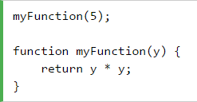
Function Hoisting
A function can be used before it is declared
Hoisting (JS behavior) moves all declarations to the top of current scope.

Slide 38

Self-invoked Function
Immediately Invoked Function Expression (IIFE)
Is invoked automatically, without being called.
Will execute automatically if the expression is followed by ().

Slide 39
Function
Demo

Slide 40
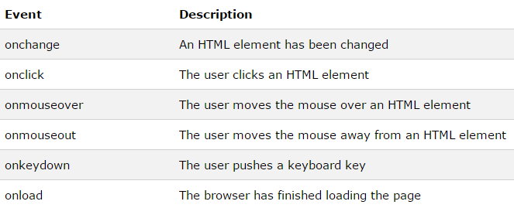
Events
Html event can be something browser does, or something user does.
Syntax:
<button onclick="displayDate()">The time is?</button>

Slide 41
Constructor Function
When invoked with new keyword, function returns an object known as this.
We can modify properties and methods of this before it’s returned.
var Person = function(name) {
this.name = name;
this.speaks = 'fr';
this.say = function() {
return "Je m'appelle " + this.name;
};
};

Slide 42
Constructor Function
An object created with Constructor.
>>> var julien = new Person("Julien");
>>> julien.say();
"Je m'appelle Julien"

Slide 43
Constructor Function
Built-in constructor functions
Object
Array
Function
RegExp
Number
String
Boolean
Date
Error, SyntaxError, ReferenceError…

Slide 44
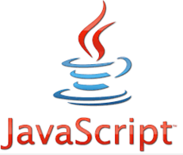
Constructor
Use this | Not that
var o = {}; | var o = new Object();
var a = []; | var a = new Array();
var re = /[a-z]/gmi; | var re = new RegExp( '[a-z]', 'gmi');
var fn = function(a, b){ return a + b; } | var fn = new Function( 'a, b','return a+b');

Slide 45
JavaScript Prototype

Slide 46
Prototype
Every JavaScript object has a prototype.
Prototype is also an object.
All JavaScript objects inherit the properties and methods from their prototype.
Objects created using an object literal, or with new Object(), inherit from a prototype called Object.prototype.
The Object.prototype is on the top of
prototype chain.

Slide 47
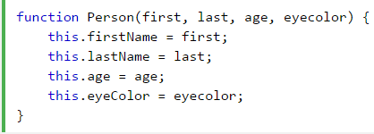

Create Prototype
Create prototype using constructor function
Create new objects from same prototype

Slide 48
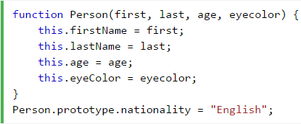
Using prototype Property
Add new properties to existing prototype

Slide 49
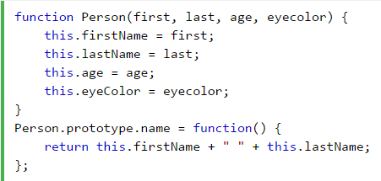
Using prototype Property
Add new methods to existing prototype

Slide 50
Prototype
Demo

Slide 51
JavaScript Closure

Slide 52
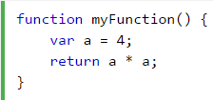
Variable Scope
Local variable
Can only be accessible from inside a function where it is defined.
Is hidden from other functions and other scripting code.

Slide 53
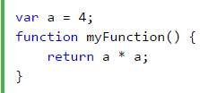
Variable Scope
Global variable
Can be accessible and changed from everywhere in the page.
Belongs to the window object in the web page.
Notes:
Variables created without the keyword var, are always global, even if they are created inside a function.

Slide 54
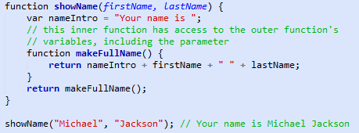
Closure
What is Closure?
A closure is an inner function that has access to outer function’s variables
Three scope chain:
Access to its own scope
Access to outer function’s variables
Access to global variables

Slide 55
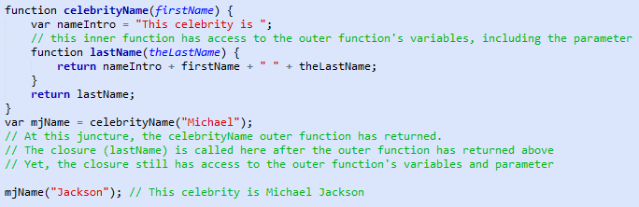
Closure
Closure Effects
Closures have access to the outer function’s variable even after the outer function returns.

Slide 56
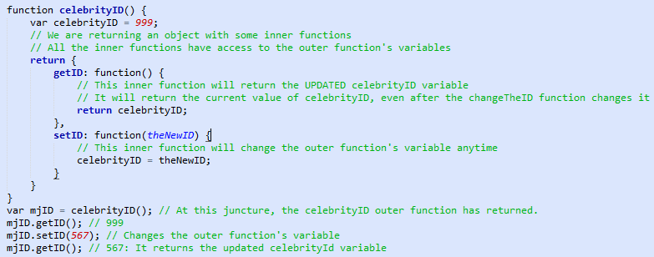
Closure
Closure Effects
Closures store references to the outer function’s variables.

Slide 57
Closure
Demo

Slide 58
Ajax

Slide 59
Problem with traditional web?
In traditional web, to get information from server:
Make html form
GET or POST data to the server (like Submit button)
The browser loads a result page.
Traditional web app run slowly and tend to be less user friendly.
Notes:
http://blog.cloudfour.com/2011/09/

Slide 60

Why Ajax come in?
AJAX = Asynchronous JavaScript and XML
Ajax does not require the page to be reloaded.
Use XmlHttpRequest object
The scripts requested to the server are executed asynchronously in the background.
Ajax call is asynchronous,
The browser is not locked up.
The page is reloaded partially.
Notes:
http://blog.cloudfour.com/2011/09/

Slide 61
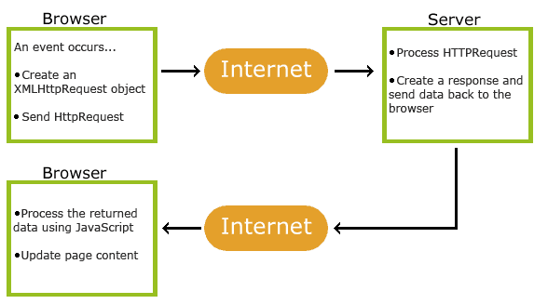
How Ajax works?
Notes:
http://blog.cloudfour.com/2011/09/

Slide 62

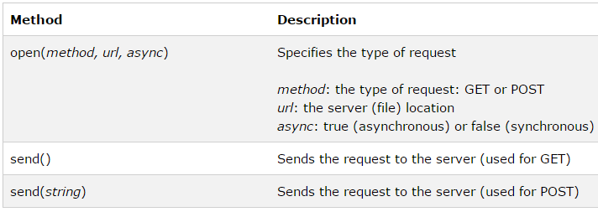
Ajax – send request
Create XmlHttpRequest object
Send request to server
Notes:
Dynamically Modify And Enhance Images By Changing Their URL
URL parameters: http://www.cdnconnect.com/docs/image-api/image-resizing
http://www.cdnconnect.com/docs/foresightjs
Picturefill: http://scottjehl.github.io/picturefill/
http://www.w3.org/community/respimg/wiki/Main_Page

Slide 63


Ajax – get or post ?
Get is simpler and faster than POST
Use POST when
Send large amount of data to server (no size limit)
Sending user input (robust and secure than GET)
Notes:
http://www.sencha.com
Sencha creates development frameworks and tools that help you design, develop, deploy applications for desktop and mobile devices. Our goal is to enhance your development experience and final results by providing well-structured, Web standards-based frameworks and tools that make drafting functional UI and CSS3 animations a breeze, and cloud services for supporting your application available anytime, anywhere.
Sencha.io Src : Optimized Fast Image Delivery Sencha.io Src sizes your images to the device that is requesting them, then caches and optimizes them for efficient repeat delivery. Retina Display? Super-AMOLED? WVGA? XVGA? No problem. Now, there’s no need to serve a lowest common denominator image to everyone. With Sencha.io Src don’t worry about scaling your image assets for the variety of mobile screens. Put a single high resolution image on your server, point your IMG tag to Src and let the cloud take care of the rest. Sencha.io Sync: Seamless Mobile Synching Sencha.io Sync is a multi-master cloud based synchronization service built for the HTML5 web. With powerful persistence capabilities, even if your mobile replica is lost, Sencha.io Sync can sync a full application data set back to where it was last, leaving your customers comfortable saving their critical data with your app.
Sencha.io Src API
The API for Sencha.io Src is very simple. Provide the URL of a large image, and Src dynamically shrinks it down. Simply provide the address of the image, indicate how you want the image to display, and Src will do the rest. http://src.sencha.io/http://www.myapp.com/myimg.jpg﻿

Slide 64
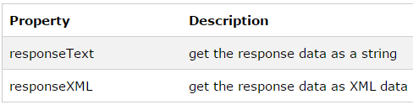
Ajax – server response
Use responseText or responseXML property of XMLHttpRequest object.
Notes:
http://www.sencha.com
Sencha creates development frameworks and tools that help you design, develop, deploy applications for desktop and mobile devices. Our goal is to enhance your development experience and final results by providing well-structured, Web standards-based frameworks and tools that make drafting functional UI and CSS3 animations a breeze, and cloud services for supporting your application available anytime, anywhere.
Sencha.io Src : Optimized Fast Image Delivery Sencha.io Src sizes your images to the device that is requesting them, then caches and optimizes them for efficient repeat delivery. Retina Display? Super-AMOLED? WVGA? XVGA? No problem. Now, there’s no need to serve a lowest common denominator image to everyone. With Sencha.io Src don’t worry about scaling your image assets for the variety of mobile screens. Put a single high resolution image on your server, point your IMG tag to Src and let the cloud take care of the rest. Sencha.io Sync: Seamless Mobile Synching Sencha.io Sync is a multi-master cloud based synchronization service built for the HTML5 web. With powerful persistence capabilities, even if your mobile replica is lost, Sencha.io Sync can sync a full application data set back to where it was last, leaving your customers comfortable saving their critical data with your app.
Sencha.io Src API
The API for Sencha.io Src is very simple. Provide the URL of a large image, and Src dynamically shrinks it down. Simply provide the address of the image, indicate how you want the image to display, and Src will do the rest. http://src.sencha.io/http://www.myapp.com/myimg.jpg﻿

Slide 65
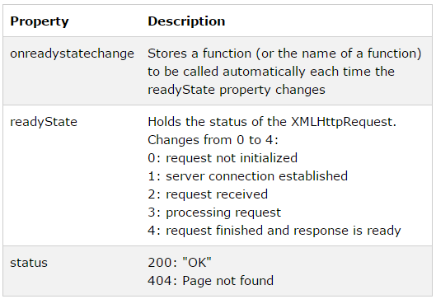
Ajax – event & callback
When a request to server is sent, perform some actions based on the response.
Notes:
http://www.sencha.com
Sencha creates development frameworks and tools that help you design, develop, deploy applications for desktop and mobile devices. Our goal is to enhance your development experience and final results by providing well-structured, Web standards-based frameworks and tools that make drafting functional UI and CSS3 animations a breeze, and cloud services for supporting your application available anytime, anywhere.
Sencha.io Src : Optimized Fast Image Delivery Sencha.io Src sizes your images to the device that is requesting them, then caches and optimizes them for efficient repeat delivery. Retina Display? Super-AMOLED? WVGA? XVGA? No problem. Now, there’s no need to serve a lowest common denominator image to everyone. With Sencha.io Src don’t worry about scaling your image assets for the variety of mobile screens. Put a single high resolution image on your server, point your IMG tag to Src and let the cloud take care of the rest. Sencha.io Sync: Seamless Mobile Synching Sencha.io Sync is a multi-master cloud based synchronization service built for the HTML5 web. With powerful persistence capabilities, even if your mobile replica is lost, Sencha.io Sync can sync a full application data set back to where it was last, leaving your customers comfortable saving their critical data with your app.
Sencha.io Src API
The API for Sencha.io Src is very simple. Provide the URL of a large image, and Src dynamically shrinks it down. Simply provide the address of the image, indicate how you want the image to display, and Src will do the rest. http://src.sencha.io/http://www.myapp.com/myimg.jpg﻿

Slide 66

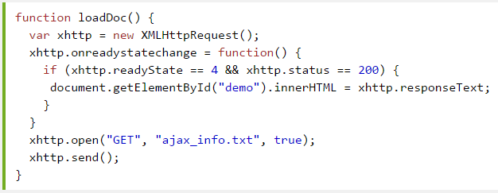
Ajax – example
Notes:
Adaptive Images
Deliver small images to small devices
Adaptive Images detects your visitor's screen size and automatically creates, caches, and delivers device appropriate re-scaled versions of your web page's embeded HTML images. No mark-up changes needed. It is intended for use with Responsive Designs and to be combined with Fluid Image techniques.

Slide 67
Ajax
Demo

Slide 68
JQuery

Slide 69

What is jQuery?
jQuery is a fast and concise JavaScript Library
Features:
that simplifies DOM traversing, event handling, animating, and Ajax interactions for rapid web development.
jQuery is designed to change the way that you write JavaScript
References:
api.jquery.com/jQuery.ajax

Slide 70
jQuery features
jQuery is a library of JavaScript functions
Write less, do more
Awesome features:
HTML element selections
HTML element manipulation
CSS manipulation
HTML event functions
JavaScript Effects and animations
HTML DOM traversal and modification
AJAX

Slide 71
Jquery – How to use?
The jQuery library is stored as a single JavaScript file, containing all the jQuery methods.
It can be added to a web page with the following mark-up:
<head>
<script type="text/javascript" src="jquery.js"> </script>
</head>
Notes:
http://css-tricks.com/responsive-data-table-roundup/

Slide 72
jQuery – how to use? (cont)
Basic syntax is: $(selector).action()
A dollar sign ($) to define jQuery
A (selector) to query (or find) elements
A jQuery action() to be performed on the element(s)
$("p").hide()
Entry point ready() function
$(document).ready(function() {
// Handler for .ready() called.
});

Slide 73
Jquery – selector
Start with $()
Selectors | Descriptions
$(“*") | selects all elements.
$(“p") | selects all <p> elements.
$("p.intro") | selects all <p> elements with class="intro".
$("p#intro") | selects the first <p> elements with id="intro".
$(":button") | selects all <button> and <input> elements of type="button".
$(":even") | selects even elements
$(":odd") | selects odd elements.
Notes:
http://css-tricks.com/responsive-data-table-roundup/

Slide 74
Jquery – event
The jQuery event handling methods are core functions in jQuery.
Event handlers are methods that are called when something happens in HTML. The term triggered (or fired) by an event is often used.
Notes:
http://css-tricks.com/responsive-data-table-roundup/

Slide 75
Jquery – event (example)
jQuery Submit is triggered whenever a visitor submits a form.
$("form").submit(function(){})
jQuery Click is triggered when you click and release the mouse button
$('#id1').click(function(){})
jQuery Mouseup and Mousedown Event
$('#id1').mousedown(function(){})
Notes:
http://css-tricks.com/responsive-data-table-roundup/

Slide 76
Jquery – effect
Hide() and show()
$(selector).hide(speed, callback)
$(selector).show(speed, callback)
The toggle()
$(selector).toggle(speed,callback)
Slide methods (slideDown, slideUp, slideToggle)
$(selector).slideUp(speed,callback)
$(selector).slideDown(speed,callback)
$(selector).slideToggle(speed,callback)
Notes:
http://css-tricks.com/responsive-data-table-roundup/

Slide 77
Jquery – effect (cont)
Fade methods (fadeIn, fadeOut, fadeTo).
$(selector).fadeIn(speed,callback)
$(selector).fadeOut(speed,callback)
$(selector).fadeTo(speed,opacity,callback)
Custom animate() function.
$(selector).animate({params},[duration],[easing],[callback])
Notes:
http://css-tricks.com/responsive-data-table-roundup/

Slide 78
jQuery – html manipulation
Changing HTML content of an element
$(selector).html(content): set the HTML contents of each element in the set of matched elements.
Add contents to an element
$(selector).append(content): inserts specified content at the end of (but still inside) the selected elements.
$(selector).prepend(content): inserts specified content at the beginning of (but still inside) the selected elements.
Notes:
http://css-tricks.com/responsive-data-table-roundup/

Slide 79
jQuery – html manipulation (cont)
More methods for HTML manipulation:
$(selector).before(content)
$(selector).after(content)
$(content).insertAfter(selector)
$(content).insertBefore(selector)
$(selector).attr(attribute)
$(selector).attr(attribute,value)
$(selector).remove()
$(selector).removeAttr(attribute)
Notes:
http://css-tricks.com/responsive-data-table-roundup/

Slide 80
jQuery – css manipulation
CSS Manipulation
$(selector).css(name)
$(selector).css(name,value)
Size manipulation
$(selector).width() and $(selector).width(value)
$(selector).height() and $(selector).height(value)
Add/remove a css class
$(selector).addClass(class)
$(selector).removeClass(class)
Check existing css class
$(selector).hasClass(class)
Notes:
http://css-tricks.com/responsive-data-table-roundup/

Slide 81
jQuery – css manipulation (cont)
More methods for CSS manipulation:
$(selector).scrollLeft()
$(selector).scrollLeft(position)
$(selector).scrollTop()
$(selector).scrollTop(position)
$(selector).position()
$(selector).offset()
$(selector).offset(value)
$(selector).toggleClass(class)
Notes:
http://css-tricks.com/responsive-data-table-roundup/

Slide 82
jQuery AJAX

Slide 83
jQuery ajax - introduction
Perform an AJAX (asynchronous HTTP) request.
Methods: GET / POST / PUT / DELETE
Syntax:
$.ajax({name:value, name:value, ... })
The parameters specifies one or more name/value pairs for the AJAX request.
Notes:
Refer to http://bradfrost.com/blog/web/responsive-nav-patterns/ for more information

Slide 84
$.ajax options : URL
Address of the server-side resource
Can contain query string
Can be passed as a string to first argument
$.ajax({
url: '/url/to/serverResource'
});
$.ajax('/url/to/serverResource');
Notes:
Refer to http://bradfrost.com/blog/web/responsive-nav-patterns/ for more information

Slide 85
$.ajax options : data
To send information from client to server
with GET: Appended to url as query string
with POST: Sent as POST body
$.ajax({
url: '/url/to/serverResource',
data: {
key1: 'value1',
key2: 'value2'
}
});
Notes:
Refer to http://bradfrost.com/blog/web/responsive-nav-patterns/ for more information

Slide 86
$.ajax options : data (cont)
When submitting a form, use .serialize( )
$('#myform').submit(function(event) {
event.preventDefault();
var formUrl = $(this).attr('action'),
formData = $(this).serialize();
$.ajax({
url: formUrl,
data: formData
});
});
Notes:
Refer to http://bradfrost.com/blog/web/responsive-nav-patterns/ for more information
Encode a set of form elements as a string for submission.

Slide 87
$.ajax options : datatype
Specifies expected response
Default based on MIME Type of the response
Available data type: html, xml, json , jsonp.
$.ajax({
url: '/url/to/serverResource',
dataType: 'json'
});
Notes:
Refer to http://bradfrost.com/blog/web/responsive-nav-patterns/ for more information

Slide 88
$.ajax options : more…
Read all about 'em at
api.jquery.com/jQuery.ajax/
Notes:
Refer to http://bradfrost.com/blog/web/responsive-nav-patterns/ for more information

Slide 89
$.ajax responses
Before jQuery 1.5, it was handled by 3 more options.
{ success: function(){}, error: function(){}, complete: function(){} }
Can not register multiple callbacks
$.ajax({
url: '/url/to/serverResource',
success: function(response, status, xhr) {
// do something after successful request
},
error: function(xhr, status, errorThrown) {
// handle failed request
},
complete: function(xhr, status) {
// do something whether success or error
}
});
Notes:
Refer to http://bradfrost.com/blog/web/responsive-nav-patterns/ for more information

Slide 90
$.ajax responses (cont)
$.ajax implements the Promise interface
returns a jqXHR promise object (superset of xhr)
Promise objects are derived from the Deferred object
Read api.jquery.com/category/deferred-object/
jQuery 1.5+:
.done() and .fail() methods
jQuery 1.6+:
.always() method
Notes:
Refer to http://bradfrost.com/blog/web/responsive-nav-patterns/ for more information

Slide 91
$.deferred
3 important methods
.resolve()
.reject()
.promise()
3 important events to attach a callback
.done()
.fail()
.always()
Notes:
Refer to http://bradfrost.com/blog/web/responsive-nav-patterns/ for more information

Slide 92
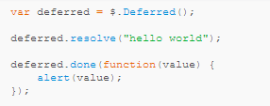
$.deferred (cont)
Once resolve() is called, the .done callback attached will be executed.
Once reject() is called, the .fail callback attached will be executed.
The .always() is executed whether the deferred is resolved or rejected.
Notes:
Refer to http://bradfrost.com/blog/web/responsive-nav-patterns/ for more information

Slide 93
.promise() method
Another important method of deferred object.
Returns an object with almost the same interface than the Deferred, but
it only has then method to attach callbacks
it does not have the methods to resolve and reject.
The $.ajax method in JQuery returns a Promise
Can add as many callbacks as you want
Notes:
Refer to http://bradfrost.com/blog/web/responsive-nav-patterns/ for more information

Slide 94
$.ajax responses (1.5+)
Methods can be called multiple times to add more than one handler.
Can store result of Ajax request in variable and attach handlers later for more manageable code structure.
Handlers will be invoked immediately if the Ajax operation is already completed.
Notes:
Refer to http://bradfrost.com/blog/web/responsive-nav-patterns/ for more information

Slide 95
$.ajax responses (1.5+)
var myOptions = {
url: 'http://api.jquery.com/jsonp/',
dataType: 'jsonp',
data: {
title: search
}
};
$.ajax( myOptions )
.done( successFn )
.fail( errorFn )
.always( completeFn );
Notes:
Refer to http://bradfrost.com/blog/web/responsive-nav-patterns/ for more information

Slide 96
$.ajax responses (1.5+)
Multiple function arguments
Array of functions
Multiple, chained .done() methods
request.done(successFnA, successFnB, successFnC);
request.done([successFnD, successFnE, successFnF]);
request.done(successFnG).done(successFnH).done(successFnJ);
Notes:
Refer to http://bradfrost.com/blog/web/responsive-nav-patterns/ for more information

Slide 97
$.ajax convenience methods
$.get()
$.post()
$.getJSON()
$.getScript()
My recommendation:
Use $.ajax()
Notes:
Refer to http://bradfrost.com/blog/web/responsive-nav-patterns/ for more information

Slide 98
JQuery AJAX
Demo

Slide 99
Q&A

Slide 100
Thank you!

